Slide 1
W3C Web of Things Status and Applicatons
Michael McCool
11 January 2023
IEEE CCNC 2023 - IIWoT Workshop

Slide 2
Outline
What is WoT?
Applying and extending web standards for IoT
Descriptive interoperability: Thing Descriptions
Finding Thing Descriptions: Discovery
Use Cases and Requirements
Recent Activity
Testfest/Plugfest
Applications
Discussion
Gaps and Future Work

Slide 3




W3C Web of Things (WoT)
W3C Working Group goal: Adapting web technologies to IoT
Already published: Thing Description (TD) metadata format
TD describes the available interactions (network API) of a Thing
New deliverables in progress, including Discovery and Profiles
How does a potential consumer obtain the TD for a Thing?
What constraints on TDs are appropriate for best practices and interoperability?
App
App
App
App
App
App
WoT API
WoT API
WoT API
{ properties, actions, events }
MQTT
KNX
TLV
ECHONET
Bearer
EXI
HTTP
OAUTH2
WS
XML
MQTT
KNX
TLV
ECHONET
Bearer
EXI
JSON
Modbus
CBOR
OPC-UA
API Key
HTTP
OAUTH2
CBOR
WS
XML
BACnet
AMQP
JSON
Modbus
BACnet
OPC-UA
API Key
AMQP

Slide 4
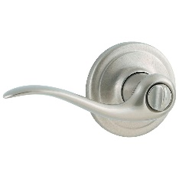
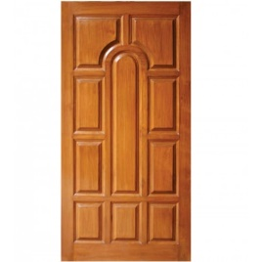
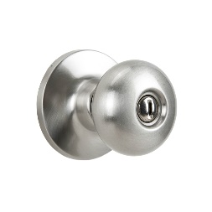
Descriptive Interoperability: TDs
WoT Architecture
Constraints
"Things" must have a TD
Must use URIs, IANA media types, etc.
Thing Description Affordances
Describes WHAT the possible choices are
Describes HOW to interact with the Thing
WoT Thing Description (TD)
{
"@context": [
"https://www.w3.org/2022/wot/td/v1.1",
{ "iot": "http://iotschema.org/" }
],
"id": "urn:dev:org:32473:1234567890",
"title": "MyLEDThing",
"description": "RGB LED torchiere",
"@type": ["Thing", "iot:Light"],
"securityDefinitions": {
"default": {"scheme": "bearer"}
},
"security": ["default"],
"properties": {
"brightness": {
"@type": ["iot:Brightness"],
"type": "integer",
"minimum": 0,
"maximum": 100,
"forms": [ ... ]
}
},
"actions": {
"fadeIn": {
...
Pull
Handle = Affordance
What?
How?
Door = Thing
Open
Turn

Slide 5
Usage Patterns Overview

Slide 6
Deliverables
New/Updated Normative Documents:
Architecture 1.1: https://github.com/w3c/wot-architecture
Thing Description 1.1: https://github.com/w3c/wot-thing-description
Discovery: https://github.com/w3c/wot-discovery
Profiles: https://github.com/w3c/wot-profile
New/Updated Informative Documents:
Binding Templates: https://github.com/w3c/wot-binding-templates
Scripting API: https://github.com/w3c/wot-scripting-api
Use Cases and Requirements: https://github.com/w3c/wot-usecases
Community Resources:
Web Site: https://www.w3.org/WoT/

Slide 7
Use Cases and Requirements
Informative Deliverable: https://github.com/w3c/wot-usecases
Purpose and Process:
Identify specific use cases
Identify application domains
Collect use cases from other W3C groups
Collect use cases from other stakeholders and SDOs
Identify usage patterns
For example, hubs, proxies, automation, etc.
Identify relevant technologies
For example, edge computing, digital twins, etc.
→ Extract common requirements to drive current and future work

Slide 8
Use Cases / Requirements Process
Spec creation (WG)
Use Case TF (IG)
Security
Shortlist
Gaps
TD
Use Case
Use Case
s
Use Case
Requirement
Use Case
Scripting
New Building Block
Discovery
System Architecture / Configuration
Profile
WoT Deliverables

Slide 9
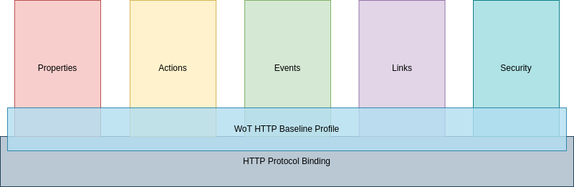
Profiles
Set of constraints to:
Improve interoperability
Define best practices
Prescriptive
Why:
TDs are descriptive
Some devices that need to be described do not follow best practices, e.g. for security
TDs are extensible
To interoperate device manufacturers need to know in advance what to expect
Currently focused on HTTP Baseline Profile and two sub-profiles for SSE and WebHook Event mechanisms
TDs satisfying profile set "profile" member and must follow constraints of profile
Things and Consumers that implement profile also need to satisfy a set of other assertions

Slide 10
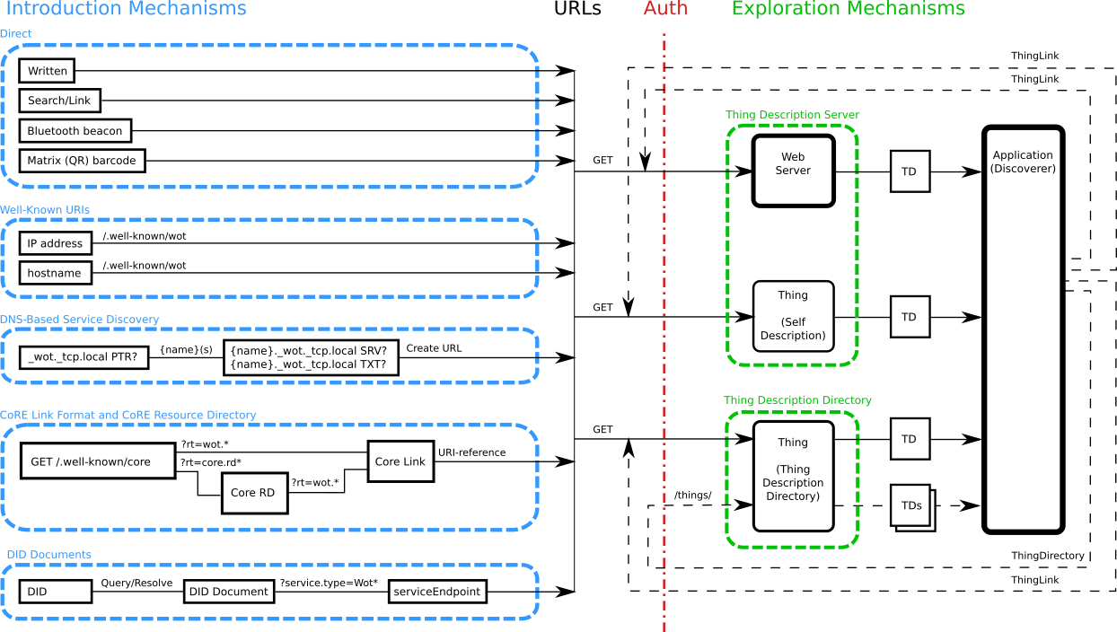
Discovery
Goal: Obtain TD of interest
Not limited to local network
Scalable to many TDs
Need to preserve privacy
Phased access:
Introduction: open
Exploration: controlled
Searchable via JSON Path, XPath, or SPARQL
Future work:
Find "nearby" Things using geospatial data

Slide 11

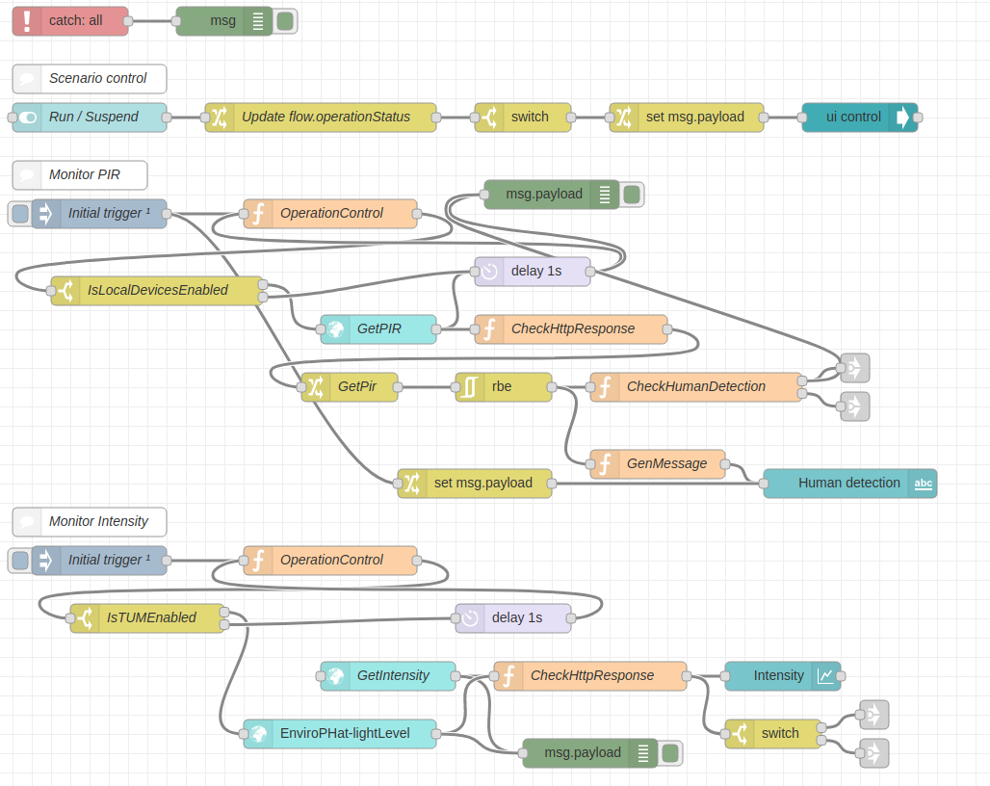
Orchestration
node-wot/Scripting API
WoTHelpers.fetch( "coap://localhost:5683/counter" ).then( async (td) => {
// using await for serial execution (note 'async' in then() of fetch())
try {
const thing = await WoT.consume(td);
console.info( "=== TD ===" );
console.info(td);
console.info( "==========" );
// read property #1
const read1 = await thing.readProperty( "count" );
console.info( "count value is" , await read1.value());
// increment property #1 (without step)
await thing.invokeAction( "increment" );
const inc1 = await thing.readProperty( "count" );
console.info( "count value after increment #1 is" , await inc1.value());
// increment property #2 (with step)
await thing.invokeAction( "increment" , {'step' : 3});
const inc2 = await thing.readProperty( "count" );
console.info( "count value after increment #2 (w/ step 3) is" , await inc2.value());
// decrement property
await thing.invokeAction( "decrement", undefined, {
formIndex: getFormIndexForDecrementWithCoAP(thing);
} );
const dec1 = await thing.readProperty( "count" );
console.info( "count value after decrement is" , await dec1.value());
} catch(err) {
console.error( "Script error:", err);
}
}).catch( (err) => { console.error( "Fetch error:", err); });
Node-RED/node-gen

Slide 12
Recent Activity
Testing new Candidate Recommendations
https://github.com/w3c/wot-testing/tree/main/events
New Commercial Usages
Takenaka Construction, Netzo, Siemens, Deutsch Telekom, Ditto, ...
Directory Implementations
WoT Hive, LogiLab (SPARQL based), Fraunhofer LinkSmart, TinyIoT, Zion
IETF Relationships: JSON Path, CoreRD, COSE/JOSE, ASDF
Under Discussion:
New Charter: New Deliverables, Updates to existing specifications, Liaisons
Geolocation, Onboarding, Historical data: proposals/deliverable-proposals

Slide 13


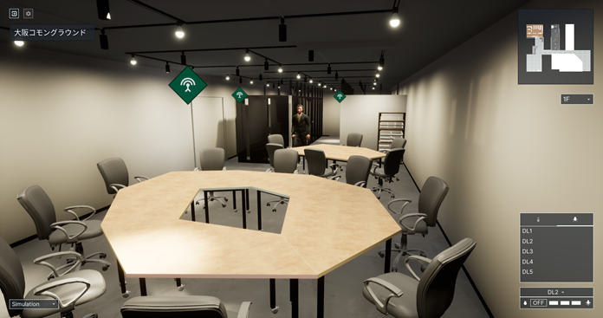

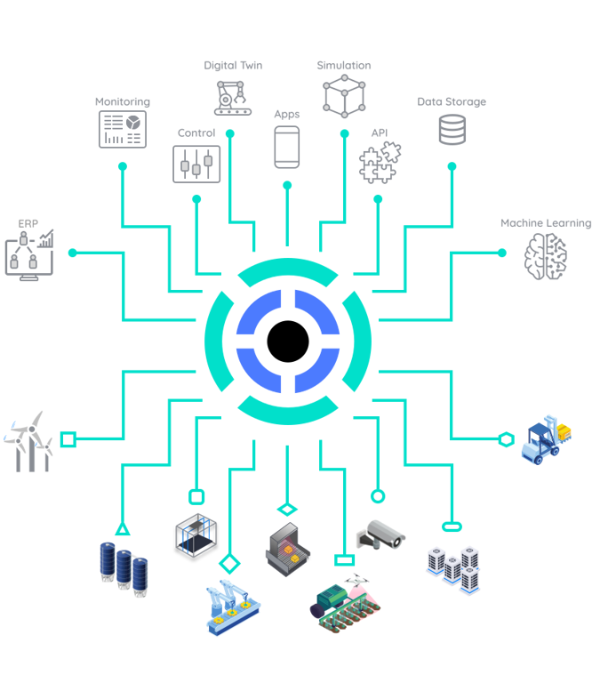


Applications
https://new.siemens.com/global/en/products/buildings/automation/desigo.html
https://www.evosoft.com/en/digitalization-offering/saywot/
https://www.evosoft.com/en/application-of-the-w3c-web-of-things-standard-in-the-wunsiedel-hydrogen-generation-plant/
Siemens AG
Desigo CC – BIM
Asset Performance Suite
Say WoT! (Evosoft)
Wunsiedel (H₂ Generation plant)
https://www.takenaka.co.jp/news/2021/05/02/
Takenaka Corporation
CGLL Platform - BIM
https://www.eclipse.org/ditto/2022-03-03-wot-integration.html
Eclipse (Bosch, Siemens, ...)
Digital twin
https://www.smarthome.de/magentazuhause-app
Deutsche Telekom AG
Smart Home
App/Hub/Cloud
https://netzo.io/
Netzo
IoT Data Hub
Dashboards
https://www.sifis-home.eu/
Horizon 2020 Project
Trustworthy Connected Home

Slide 14


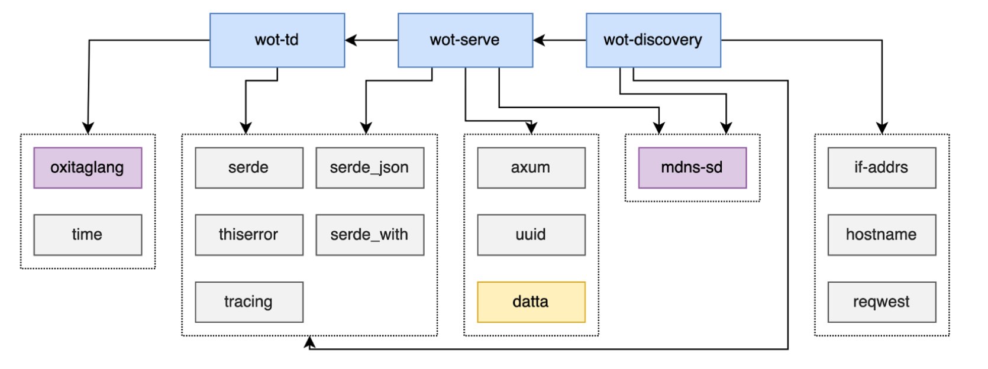
SIFIS Home
Horizon 2020 Project
https://www.sifis-home.eu/
Secure and trustworthy full-stack internet of things for Smart Home
Open Standards
Using Rust to avoid memory bugs
wot-rust implementation

Slide 15
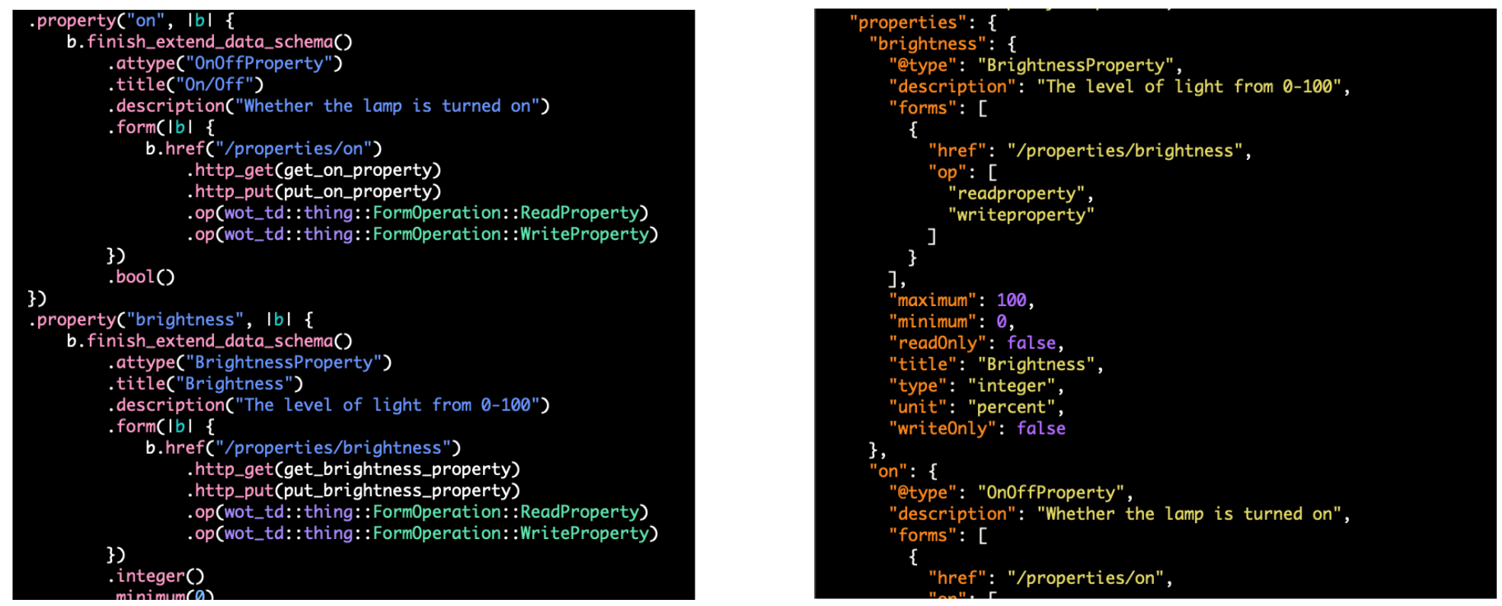
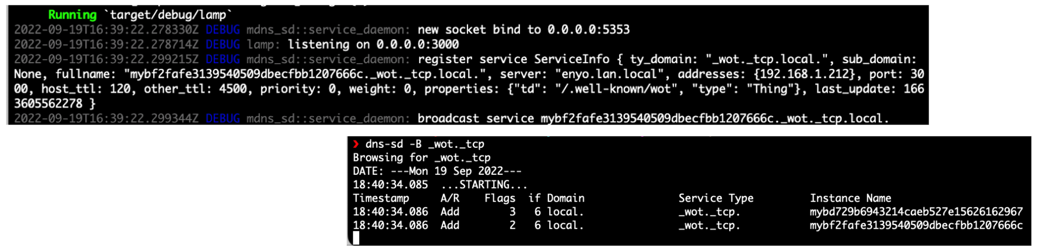
SIFIS Home

Slide 16
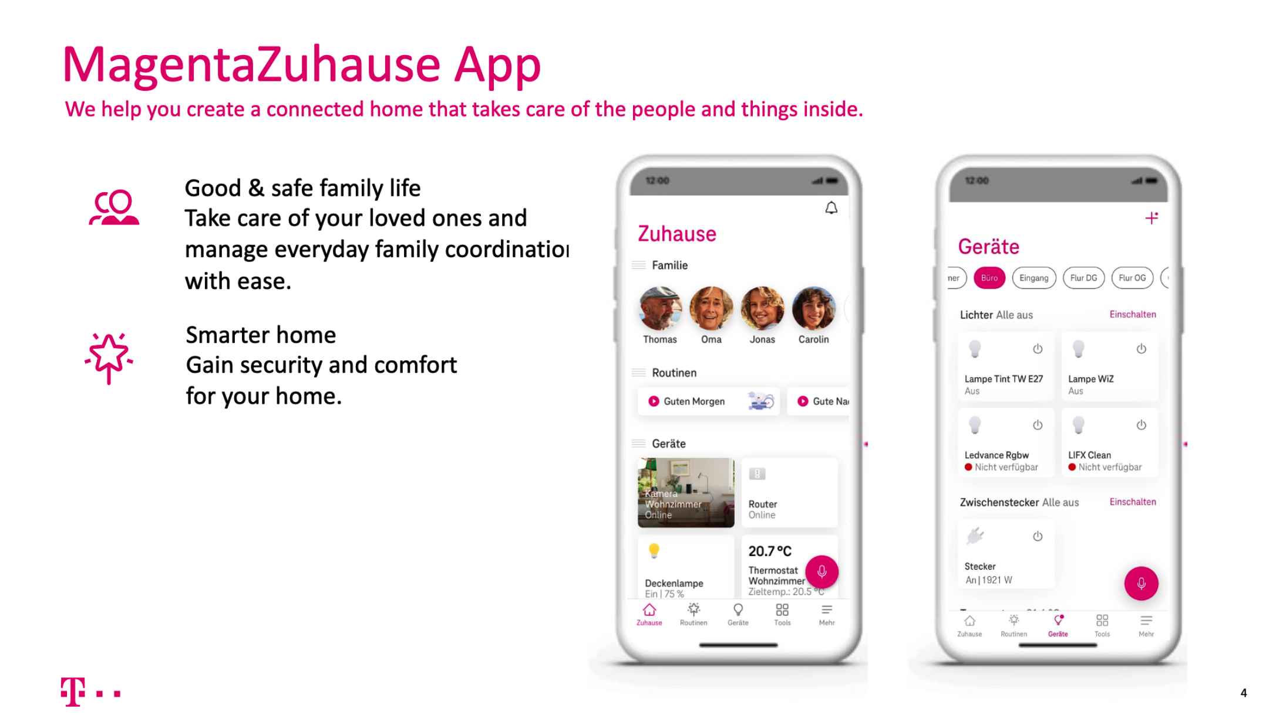

Slide 17
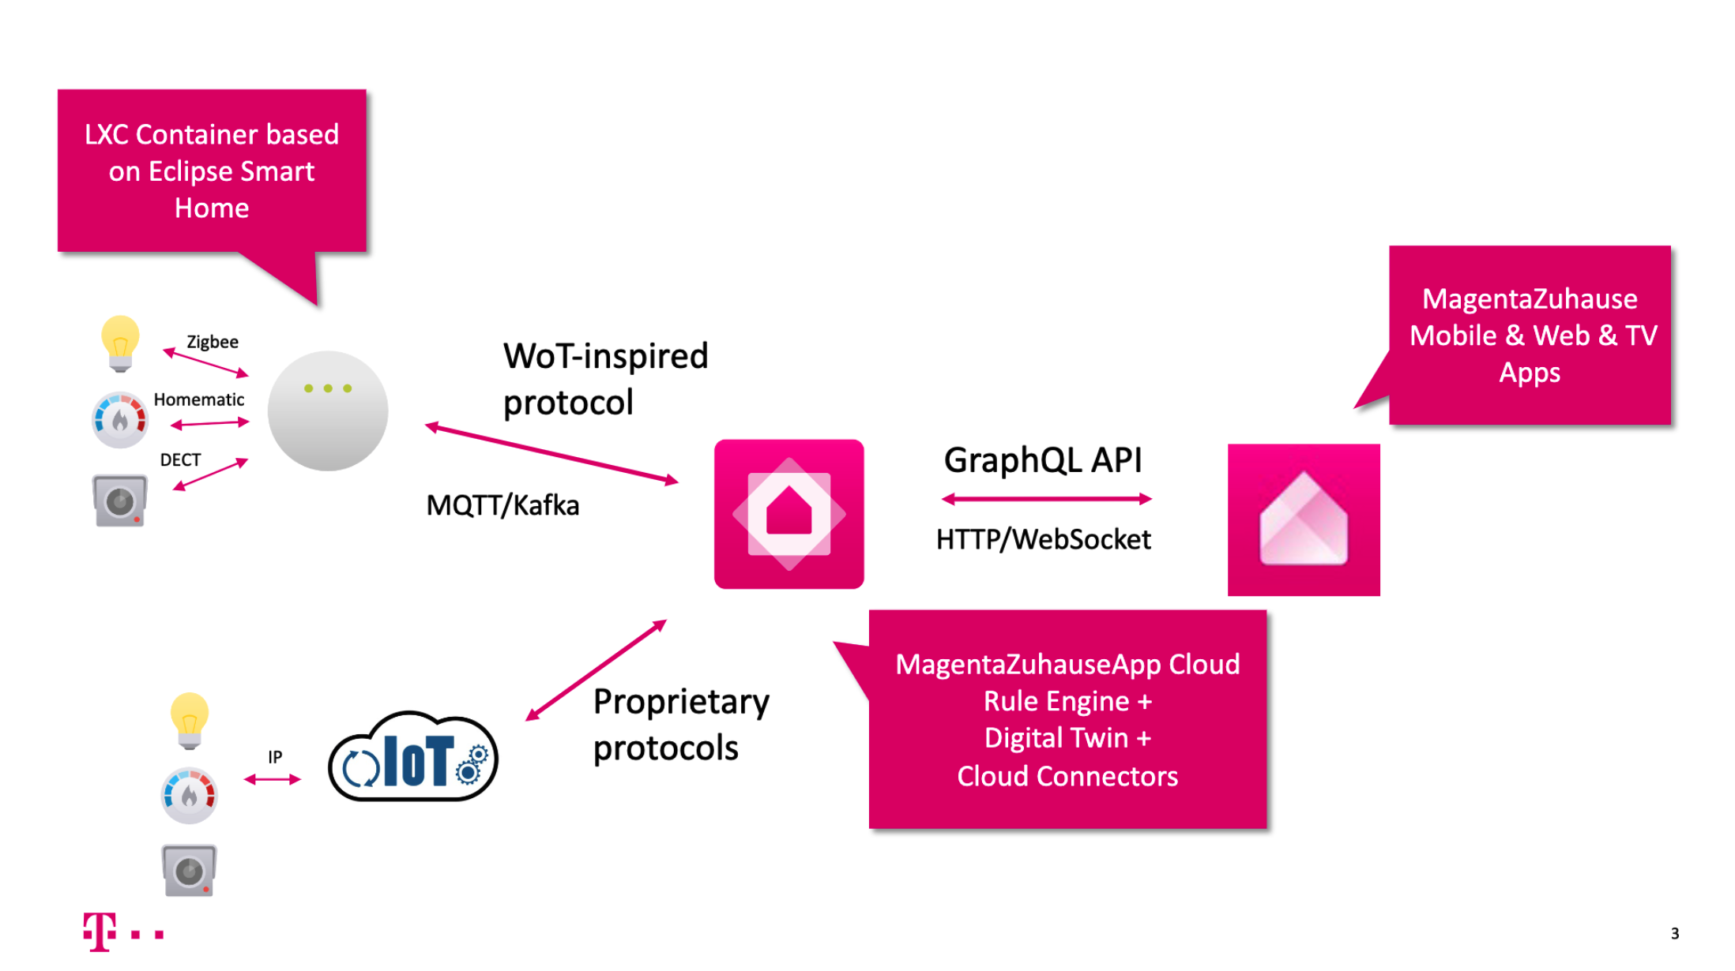

Slide 18
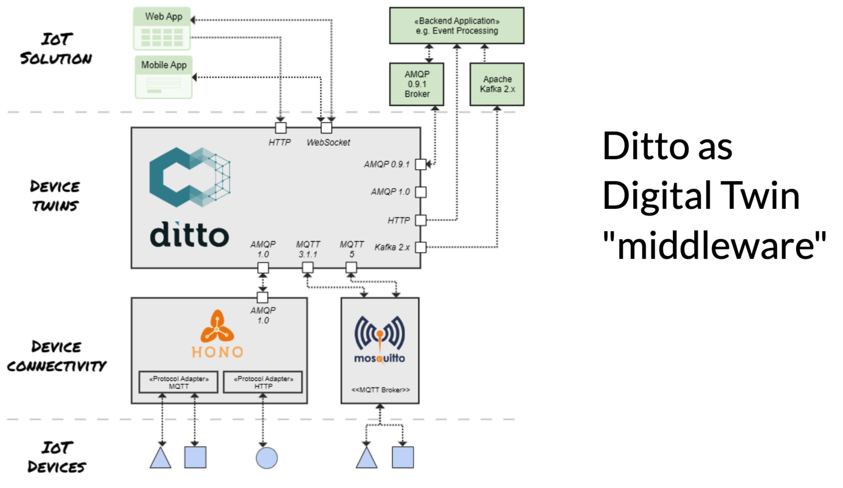
Eclipse Ditto

Slide 19
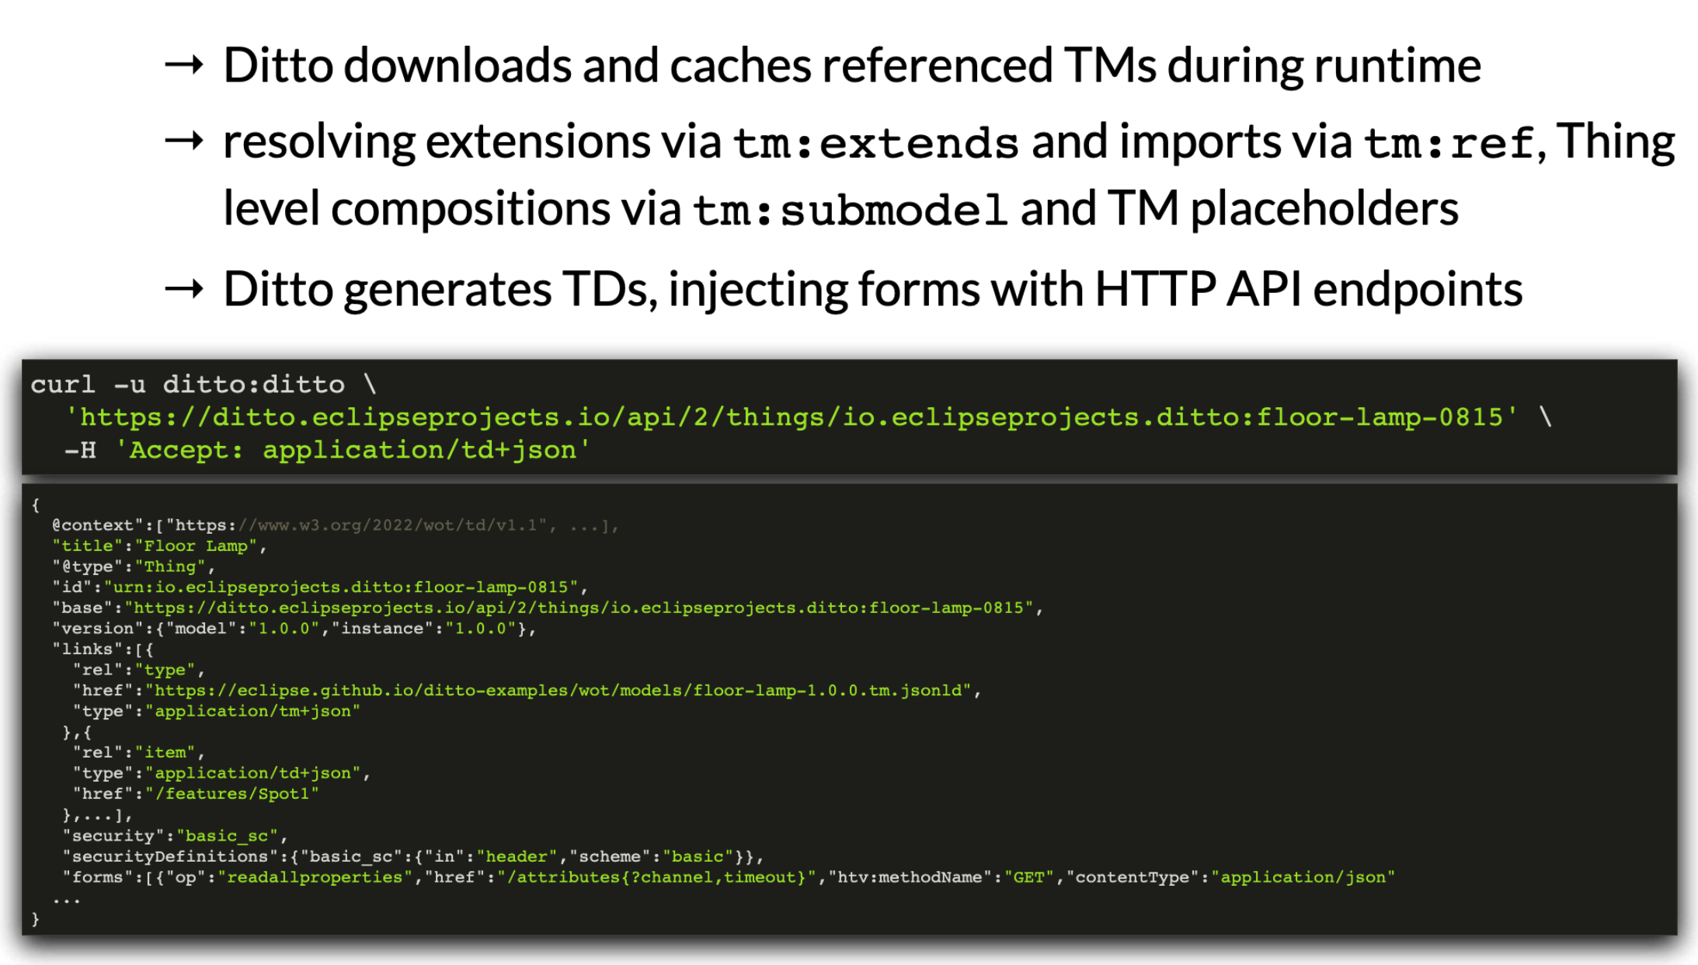
Eclipse Ditto

Slide 20
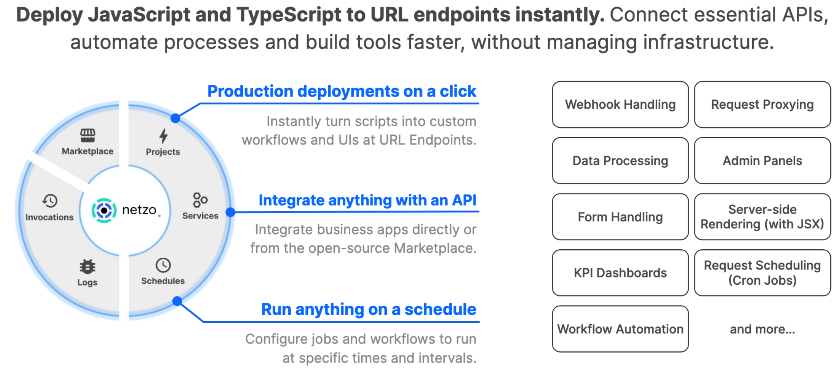
Netzo

Slide 21
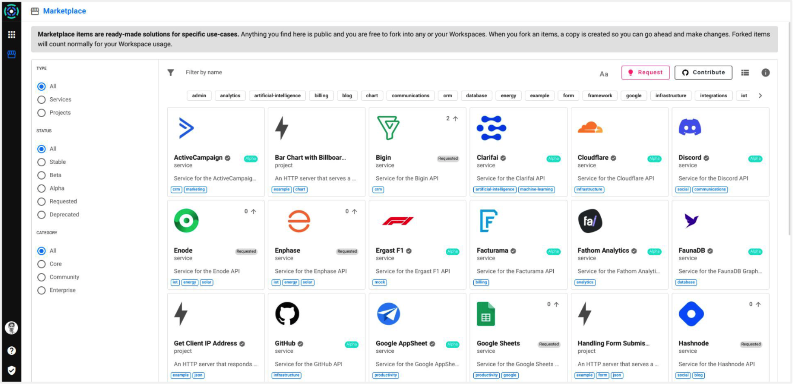
Netzo

Slide 22
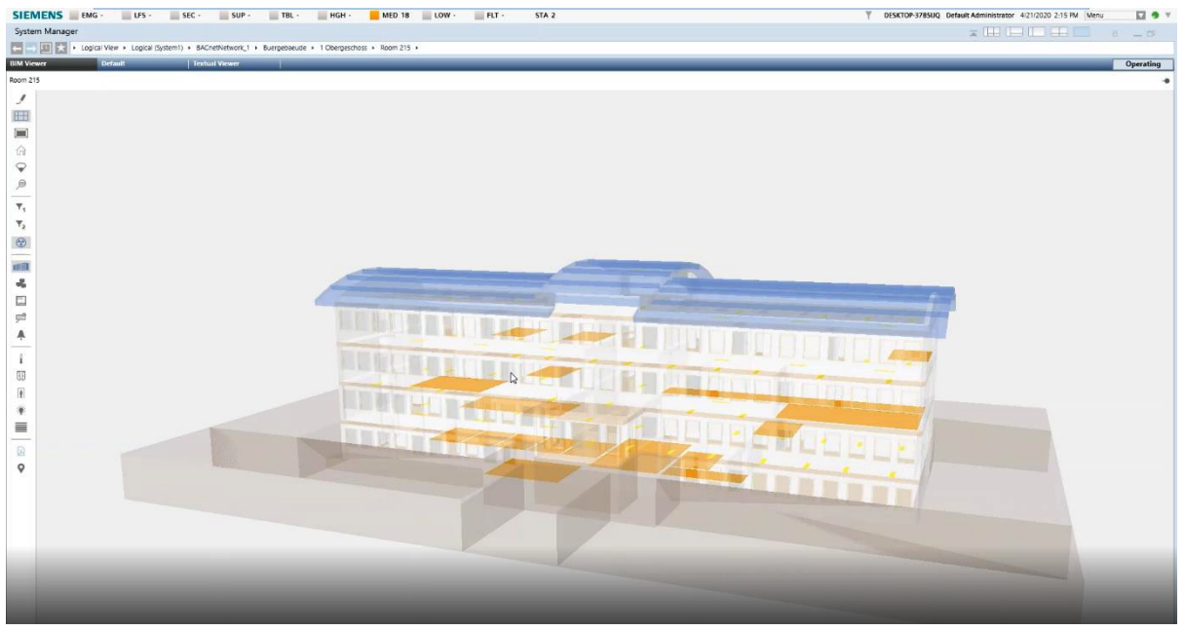
Siemens – Desigo CC
Building Information Management (BIM)
View status in context of 3D model
Security
Energy Efficiency
Maintenance management

Slide 23

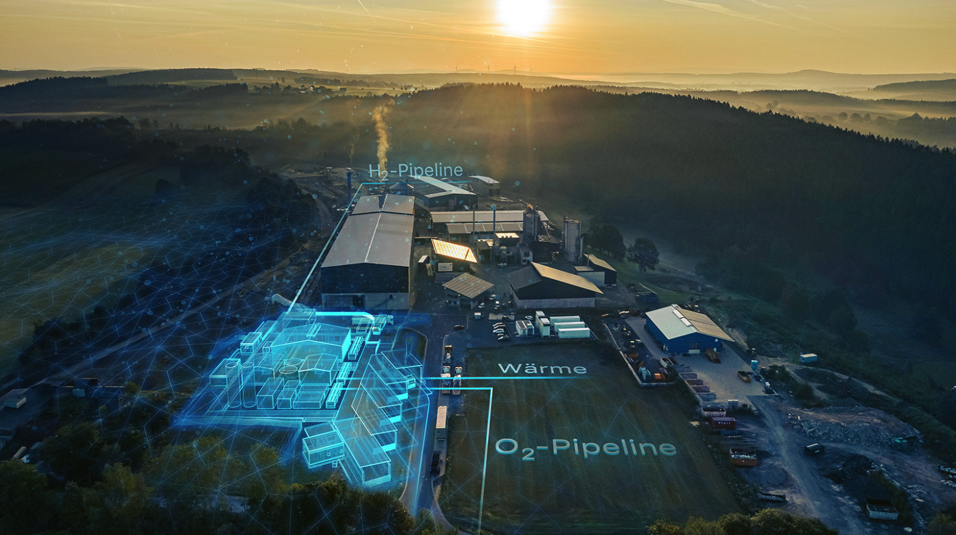
Siemens - EvoSoft
SayWoT!
https://www.evosoft.com/en/digitalization-offering/saywot/
Thing Models, Thing Descriptions, Protocol adapters...
Wunsiedel H₂ Generation Plant
https://www.evosoft.com/en/application-of-the-w3c-web-of-things-standard-in-the-wunsiedel-hydrogen-generation-plant/
Application of SayWoT to cloud integration

Slide 24
Discussion: Open Problems/Next Steps
GIS Integration
Geospatial data and discovery
Data Management
Digital Twins and shadows
Event and action modelling
Data management
Security
Key provisioning and onboarding
Secure LAN access
Proxy services
Access control and ad-hoc sharing
MUDS
Accessibility
Sensory modality mapping
Textual/descriptive interfaces
Service location
Mobility services
Advanced Use Cases
Transportation
Logistics
Distributed energy management
AR visualization
Analytics integration e.g. for health and safety monitoring

Slide 25
Resources and Contacts
https://www.w3.org/WoT
Dr. Michael McCool
Principal Engineer
Intel
Technology Pathfinding
michael.mccool@intel.com
Dr. Sebastian Kaebisch
Senior Key Expert
Siemens
Technology
sebastian.kaebisch@siemens.com

